Slide 2
Topics for Today
Introduction to Machine Learning
Introduction to NLP
Text Processing
Bag of Words (BoW) Representation
Single Layer Neural Networks
Final Project

Slide 3
Text Vectorization
Application
Sentiment Analysis
Architecture
One-layer Network
(Logistic Regression)
Multi Layer Perceptron
Vectorization
Bag of Words
Text
Pre-Processing
Tokenization + Stop Words Removal + Stemming/Lemmatization
Notes:
Our next step is vectorization. In this step, we will learn how to convert our processed text into numerical data. This is important, because machines can not use text data in its raw form. They need numerical data (representations).

Slide 4


Bag of Words (BoW)
Represents a text as a set of its words (a bag) disregarding the grammar and order of the words.
Steps:
1. Construct or get a vocabulary
2. For each text, calculate occurrences of the vocabulary words
Binary (present or not)
Frequencies
car
house
fun
learn
win
cat
good
work
Notes:
Bag of Words (BoW) is special technique to convert text data into numerical form. This methods is usually considered “old school” in this era, but as we are breaking into this field, it is a useful thing to learn.
This method represents the text as a bag of words, disregarding the grammar and order of words. Steps are as follows:
1-Create or borrow a vocabulary of words. If we don’t borrow, we create this using our training data.
2-Create simple numerical vectors by calculating the occurrences of words in your text data. These can be binary (word is there or not), simple word counts, or frequencies which are normalized according to the total number words in the text
Let’s see an example to make this clear!

Slide 5
Bag of Words (BoW)
Simple example using word counts:
“a”
“a”
“cat”
“old”
“wolf”
“it”
“is”
“my”
“is”
“dog”
“it”
“is”
“dog”
“not”
 | a | cat | dog | is | it | my | not | old | wolf
“It is a dog.” | 1 | 0 | 1 | 1 | 1 | 0 | 0 | 0 | 0
“my cat is old” | 0 | 1 | 0 | 1 | 0 | 1 | 0 | 1 | 0
“It is not a dog, it a is wolf.” | 2 | 0 | 1 | 2 | 2 | 0 | 1 | 0 | 1
Notes:
Let’s build our bag of words features. We use a vocabulary from the words that we see in these sentences. We simply count the number of times we see each word in each sentence and record it. At the end, we get a numerical representation for each text.
See the bag of words visual at top right. We don’t care about word order in this representation. It is just like throwing the words inside a bag. Here, we converted text data to numerical data.
From now on:
“it is a dog” -> [1, 0, 1, 1, 1, 0, 0, 0, 0]
“my cat is old” -> [0, 1, 0, 1, 0, 1, 0, 1, 0]
“It is not a dog, it a is wolf” -> [2, 0, 1, 2, 2, 0, 1, 0, 1]

Slide 6
Term Frequency (TF)
Term frequency (TF): Increases the weight for common words in a document.
$tf(term, doc)$= $\frac{number of times the term occurs in the doc}{total number of terms in the doc}$
 | a | cat | dog | is | it | my | not | old | wolf
“It is a dog.” | 0.25 | 0 | 0.25 | 0.25 | 0.25 | 0 | 0 | 0 | 0
“my cat is old” | 0 | 0.25 | 0 | 0.25 | 0 | 0.25 | 0 | 0.25 | 0
“It is not a dog, it a is wolf.” | 0.22 | 0 | 0.11 | 0.22 | 0.22 | 0 | 0.11 | 0 | 0.11
Notes:
If we don’t want to deal with raw count numbers, we can nicely normalize them. Term Frequency exactly does that. Normalizing input data that we use with machine learning models has some advantages for certain machine learning models.
We simply get the occurrences and divide it by the total number of words/tokens in the text. Here, we use document and text interchangeably. They mean the same thing. See that this term is larger for the words counted more in the text. This allows us to capture the frequency of the word for a given document and pass it into our numerical representation in a normalized way.

Slide 7
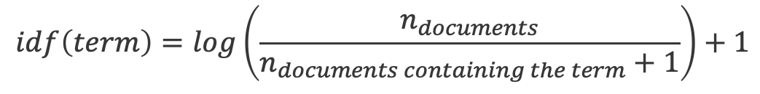
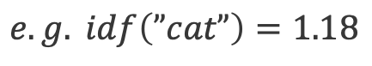
Inverse Document Frequency (IDF)
Term | Inverse Doc. Freq.
a | log(3/3)+1=1
cat | log(3/2)+1=1.18
dog | log(3/3)+1=1
is | log(3/4)+1=0.87
it | log(3/3)+1=1
my | log(3/2)+1=1.18
not | log(3/2)+1=1.18
old | log(3/2)+1=1.18
wolf | log(3/2)+1=1.18
Inverse document frequency (IDF): Increases the weights for words specific to a document (not occurring in other documents)
$$idf\left(term\right)=\log\left(\frac{n_{documents}}{n_{documents containing the term}+1}\right)+1$$
$$e.g. idf\left(”cat”\right)=1.18$$
Notes:
Now we learned how to convert the text data into numerical data. One thing we didn’t talk about is the vocabulary words themselves. How frequently do we see the word “dog” vs “plane” or “kid” across all documents? Why does this even matter? Sometimes, in text data rare words can be decisive about the overall meaning of text.
Let’s use an example here:
Assume you want to differentiate between sports documents. You have baseball, basketball and soccer related documents.
There will be some words that are common across all documents such as: “supporter”, “field”, “player”, “team”, “ball”, “sport”, “jersey”. Not that useful to understand the specific sport.
At the same time, there will be some words that are not common but can be useful to differentiate between the sports such as “goalie” -> soccer, “pitcher”->baseball, “lakers”->basketball , “ronaldo”->soccer, “jordan”->basketball, “NBA”->basketball. We almost automatically know what type of sport we are referring to with these words ☺
Inverse document frequency (IDF) assigns a weight to each word depending on how frequent that word is across all documents. This weight is big if the word is rare and small if the word is too common (that’s why it has the word “inverse” in its name). It is not a perfect method, but it allows us to incorporate the idea of word importance into our bag of words method.
SOME MATH DETAILS: The logarithm term in the equation is used to prevent this term from getting too large. +1 in the denominator makes sure the denominator is not zero which would make the logarithm go to infinity. Similarly the +1 outside the parenthesis is used for the cases we can produce “0” from the logarithm term (only when n_doc=1 and n_doc_containing=0). This +1 makes it 1 instead of 0 in that case.

Slide 8
Term Freq.-Inverse Doc. Freq (TF-IDF)
Term Freq. Inverse Doc. Freq (TF-IDF): Combines term frequency and inverse document frequency.
$$tf_{idf}(term,doc)=tf\left(term, doc\right)∗idf(term)$$
 | a | cat | dog | is | it | my | not | old | wolf
“It is a dog.” | 0.25 | 0 | 0.25 | 0.22 | 0.25 | 0 | 0 | 0 | 0
“my cat is old” | 0 | 0.3 | 0 | 0.22 | 0 | 0.3 | 0 | 0.3 | 0
“It is not a dog, it a is wolf.” | 0.22 | 0 | 0.11 | 0.19 | 0.22 | 0 | 0.13 | 0 | 0.13
Notes:
How do we use the IDF with Term Frequencies? We simply get the weight (IDF) for each word and multiply the Term Frequencies with it. At the end, this will increase the values for the rare words, reduce the ones that are common. This can help ML mode to spot more important words in text data.

Slide 9
N-gram
A sequence of n tokens from a given sample of text or speech.
Only considering single words (unigram), breaks compound words (“ice cream”) and some proper nouns (“New York”)
We can include n-grams in our term frequencies.
sentence | 1-gram(uni-gram) | 2-gram (bi-gram) | 3-gram (trigram)
It is not a dog, it is a wolf | “it”, “is”, “not”, “a”, “dog”, “it”, “is”, “a”, “wolf” | “it is”, “is not”, “not a”, “a dog”, …. | “it is not”, “is not a”, “not a dog”, ….
Notes:
So far, we learned how to calculate the numerical representations for the words/tokens. What happens if we want to capture some word forms? We shouldn’t break them, we can lose their meaning. For example: Ice cream, New York
N-gram is a technique to increase the span of words that we consider. For example, with 2-gram, we consider very 2 consecutive words as single and calculate the scores accordingly.
Be careful: If you apply this on top of your regular single tokens, you have a chance to explode your number of features! Always check the shape of your bag of words features in your code.

Slide 10

Bag of Words – Hands-on
In this exercise, we will convert text data to numerical values.
We will go over:
Binary
Word Counts
Term Frequencies
Term Freq.- Inverse Document Freq.
MLA-NLP-DAY1-BOW-NB.ipynb

Slide 11
Topics for Today
Introduction to Machine Learning
Introduction to NLP
Text Processing
Bag of Words (BoW) Representation
Single Layer Neural Networks
Final Project

Slide 12
Architecture: Single Layer Neural Networks
Application
Sentiment Analysis
Architecture
One-layer Network
(Logistic Regression)
Multi Layer Perceptron
Vectorization
Bag of Words
Text
Pre-Processing
Tokenization + Stop Words Removal + Stemming/Lemmatization
Notes:
We are at the architecture level now. First, we got our text, tokenized it, cleaned it, removed stop words and stemmed/lemmatized. Then, with bag of words method, we got numerical representation for the text data. Now, we focus on the ML model. We will learn linear and logistic regression which are some nice and simple models in ML.

Slide 13
Single Layer Neural Networks
Neural networks can be made of many stacked layers or interconnected components.
However, we will want to start out small to understand the basic theory, with single layer networks.
Output
Inputs
…

Slide 14
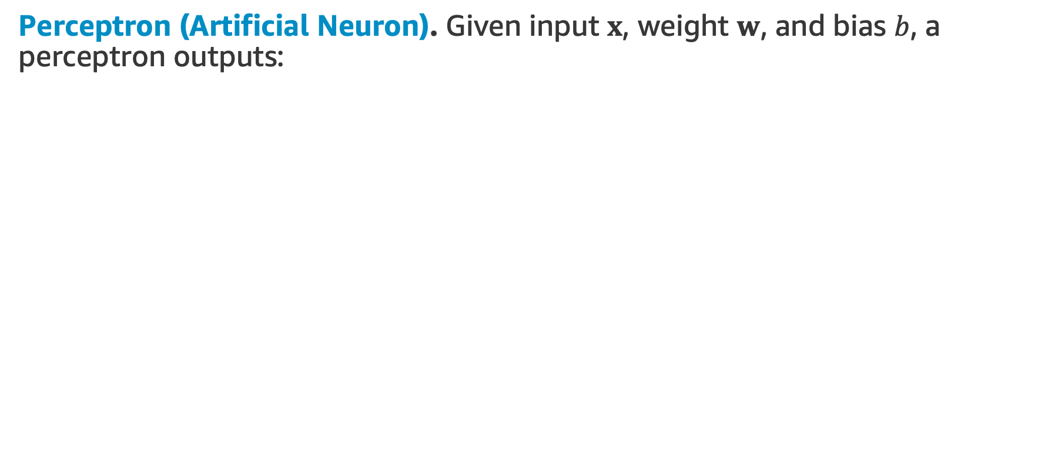
Single Layer Neural Networks
Perceptron (Artificial Neuron). Given input $x$, weight $w$, and bias $b$, a perceptron outputs:
Output
Activation Function
Weights
…
Inputs
Single layer perceptron

Slide 15
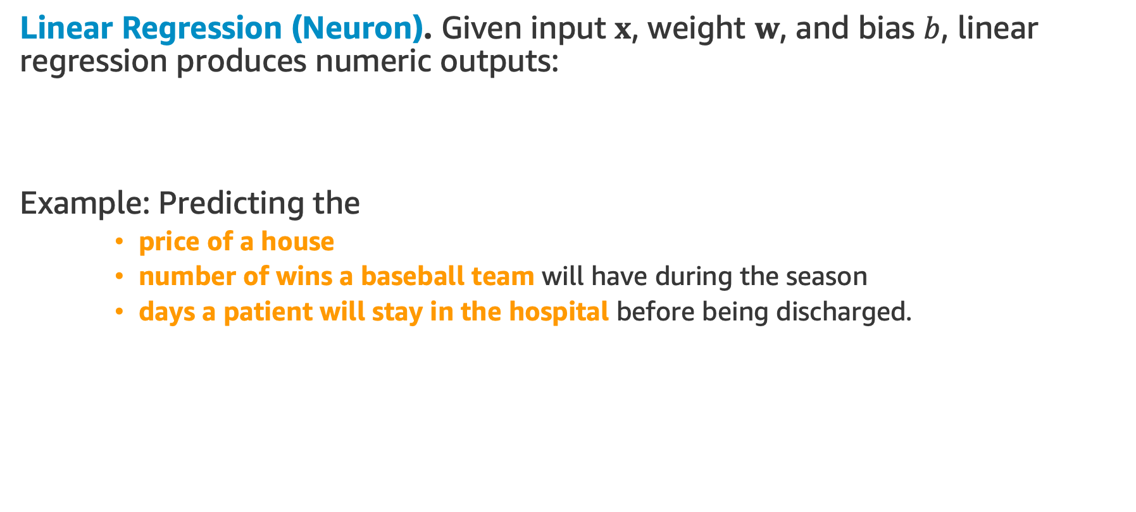
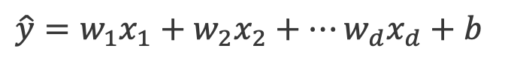
Single Layer Neural Networks
Linear Regression (Neuron). Given input $x$, weight $w$, and bias $b$, linear regression produces numeric outputs:
Example: Predicting the
price of a house
number of wins a baseball team will have during the season
days a patient will stay in the hospital before being discharged.
$\hat{y}=w_{1}x_{1}+w_{2}x_{2}+…w_{d}x_{d}+b$

Slide 16
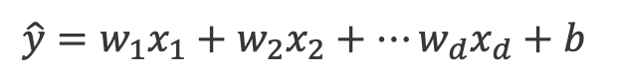
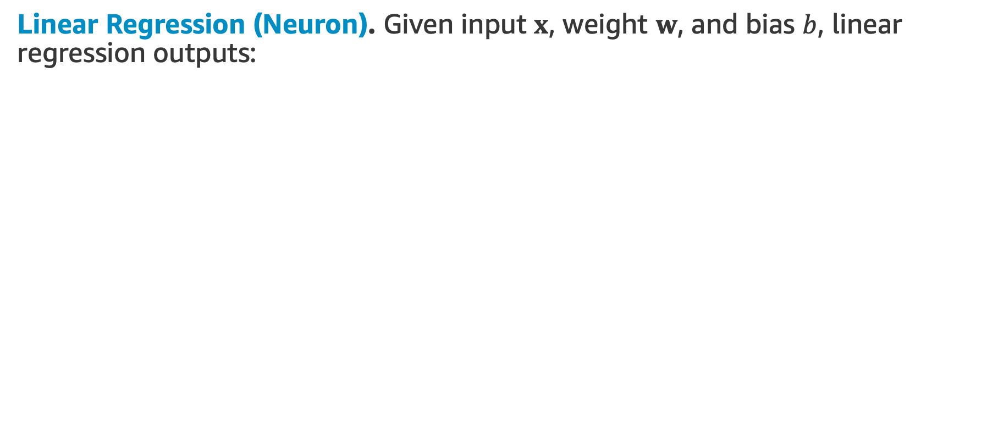
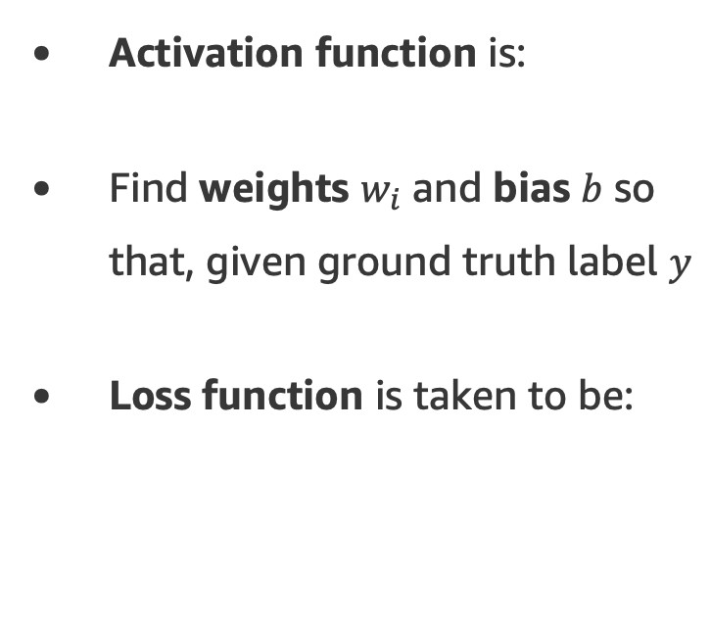
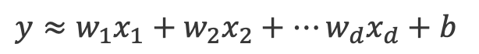
Single Layer Neural Networks
Linear Regression (Neuron). Given input $x$, weight $w$, and bias $b$, linear regression outputs:
$\hat{y}=w_{1}x_{1}+w_{2}x_{2}+…w_{d}x_{d}+b$
Activation function is:
Find weights $w_{i}$ and bias $b$ so that, given ground truth label $y$
Loss function is taken to be:
Output
Activation Function
$y≈w_{1}x_{1}+w_{2}x_{2}+…w_{d}x_{d}+b$
Weights
…
Inputs

Slide 17
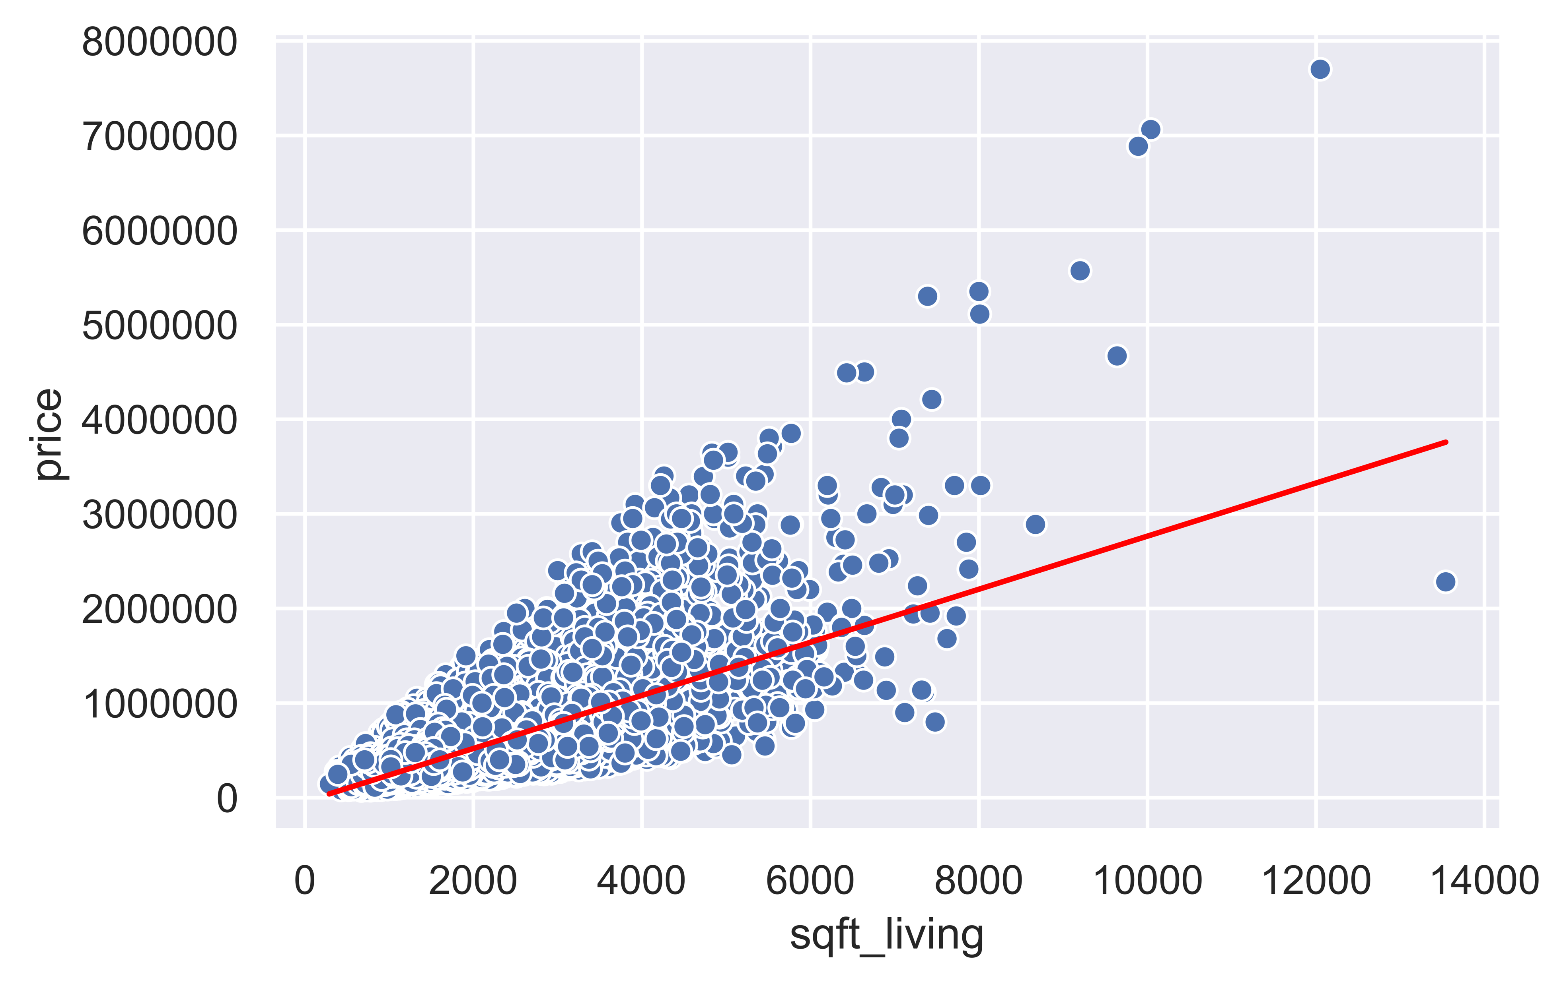
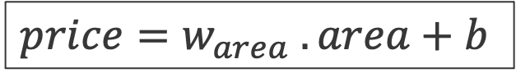
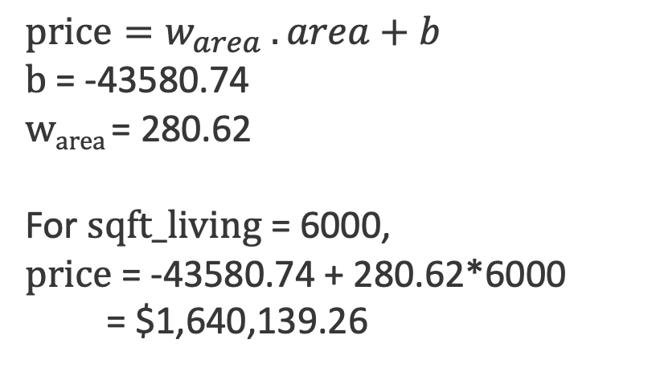
Linear Regression - Example
House price estimation using living area (square feet).
$price=w_{area} .area+b$
$$price=w_{area} .area+b$$
b = -43580.74
w_{area} = 280.62
For $sqft_living$= 6000,
$price$ = -43580.74 + 280.62*6000
= $1,640,139.26
* Data source: King County, WA Housing Info (2014).
Notes:
Let’s have an example. We use a simple house price dataset from King county, WA from 2014. Assume, we simply only use the square footage information to predict prices.
Our model is a simple line. We can write it like this: $price=w_{area} .area+b$ When we find the line, it has the following equation: $price$ = -43580.74 + 280.62*6000

Slide 18
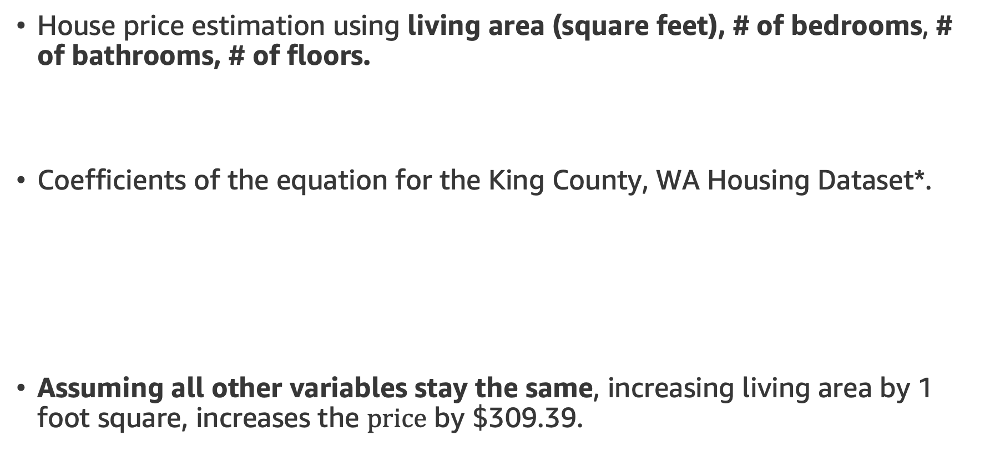
Linear Regression - Example
House price estimation using living area (square feet), # of bedrooms, # of bathrooms, # of floors.
Coefficients of the equation for the King County, WA Housing Dataset*.
Assuming all other variables stay the same, increasing living area by 1 foot square, increases the $price$ by $$\text{309.39}$.
$$price=w_{area} .area+w_{bedroom} .bedroom+w_{bathroom} .bathroom+w_{floors} .floors+b$$
w_{area} (square_feet) | w_{bedroom} | w_{bathroom} | w_{floors} | b
309.39 | -57847.96 | 7853.52 | 200.497 | 74669.67
$price=\text{309.39} x_{1}\text{−} \text{57847.96} x_{2}$ $+\text{7853.52} x_{3}+\text{200.497}{ x}_{4}+\text{74669.67}$
Notes:
Let’s extend the equation. Here, we have multiple inputs. In this case, we simply extend the equation. We have a weight for each input.
At the end, we can make sense of each weight. For example, w_{area} (square_feet) 309.39 means increasing living area by 1 foot square, increases the $price$ by $$\text{309.39}$. If this was a negative value, we could make the argument that increasing this input would decrease the house price (assuming all other inputs stay the same).

Slide 19
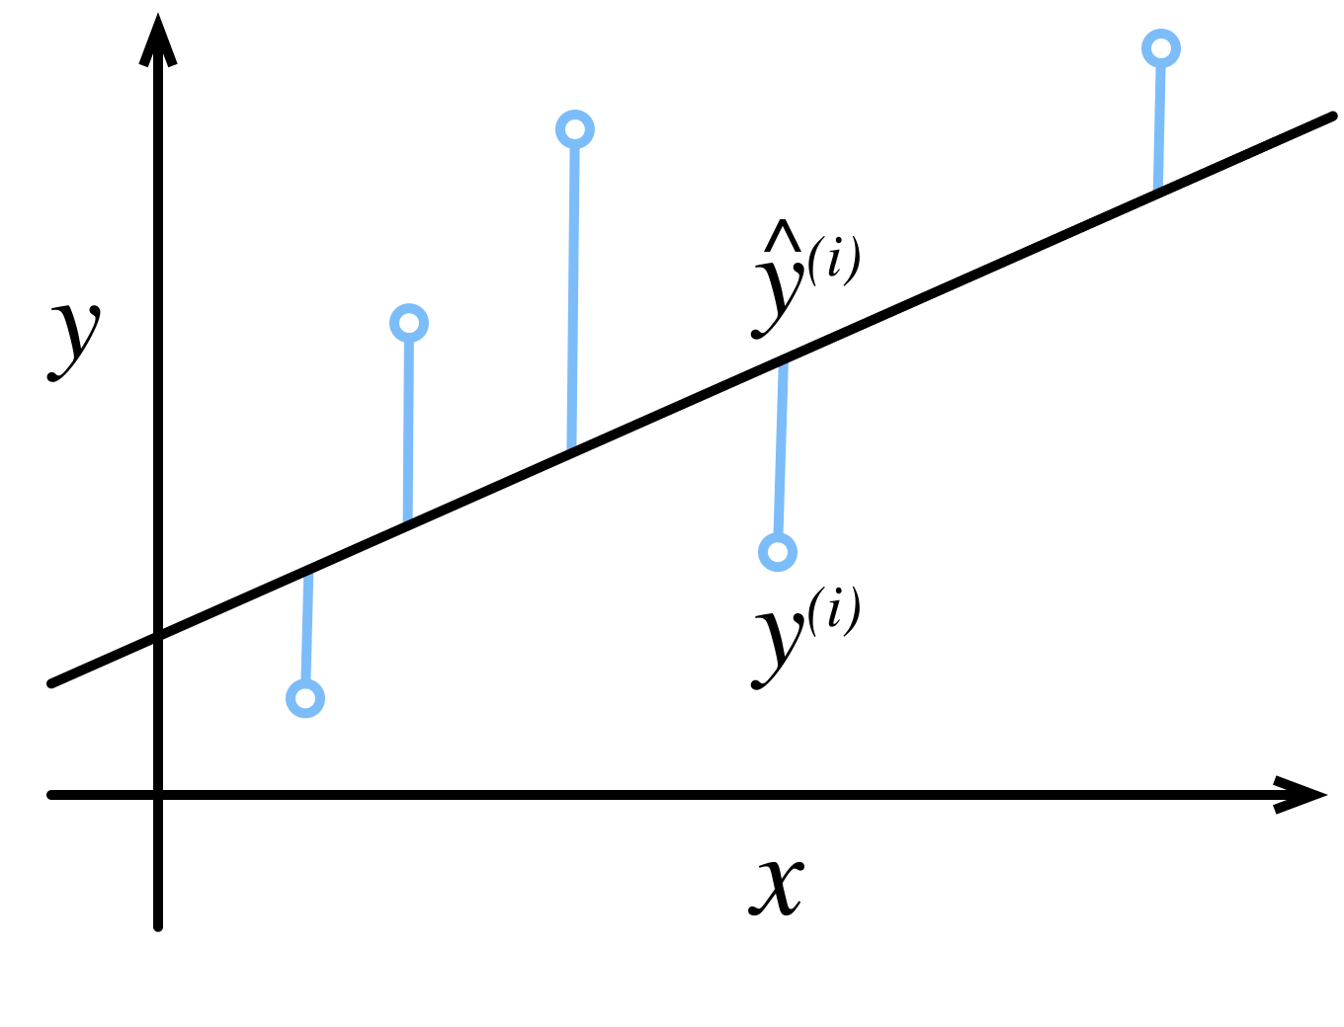
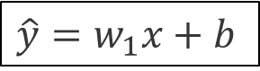
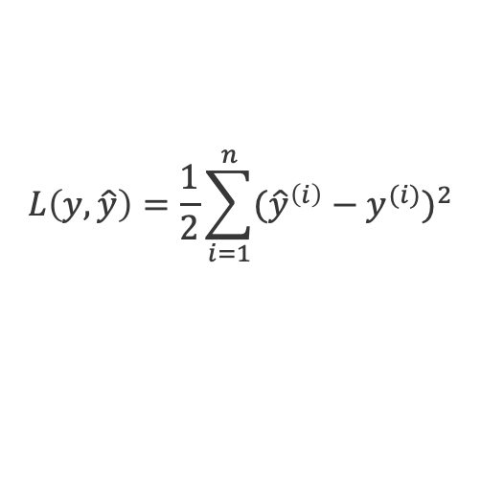
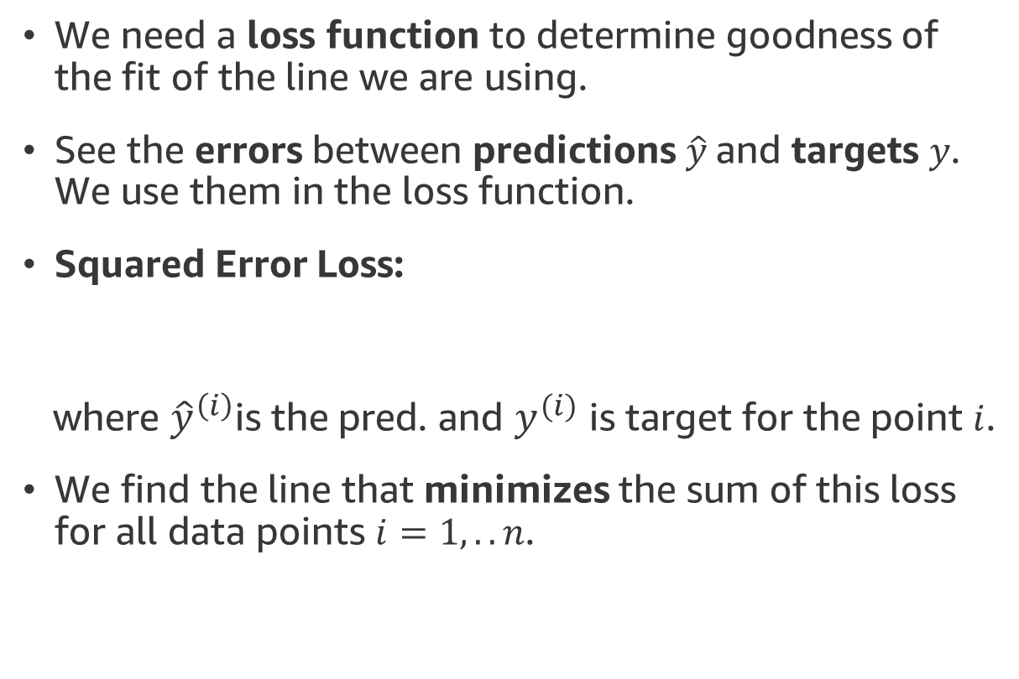
Fitting “the Line”
We need a loss function to determine goodness of the fit of the line we are using.
See the errors between predictions $\hat{y}$and targets $y$. We use them in the loss function.
Squared Error Loss:
where ${\hat{y}}^{\left(i\right)}$is the pred. and $y^{(i)}$ is target for the point $i$.
We find the line that minimizes the sum of this loss for all data points $i=1,.. n$.
error
error
error
error
$$L\left(y, \hat{y}\right)=\frac{1}{2}\sum_{i=1}^{n}{{({\hat{y}}^{\left(i\right)}−y^{(i)})}^{2}}$$
error
$\hat{y}=w_{1}x+b$
Notes:
How do we find the line? We simply define a loss function. The “best” line is the line that minimizes this loss value when we sum it over all the data points.
We define our loss as squared error loss. Why squared? Square here makes sure we don’t cancel out opposite signed errors i.e. positive and negative signed errors canceling each other.
The line equation also involves the weights. The error minimizing line is the line with the optimum weights for the given data.

Slide 20
Logistic Regression
Linear regression: Questions like How many? and How much? i.e. house price prediction, number of wins for a sports team etc.
What about problems asking “which one” instead?
Does this email belong in the spam folder or the inbox?
Is this customer more likely to sign up or not to sign up for a subscription service?
Does this image depict a donkey, a dog, a cat, or a rooster?
Notes:
Now, we finished our discussion for numeric prediction. How about discrete problems? The ones at which we predict some categories.

Slide 21
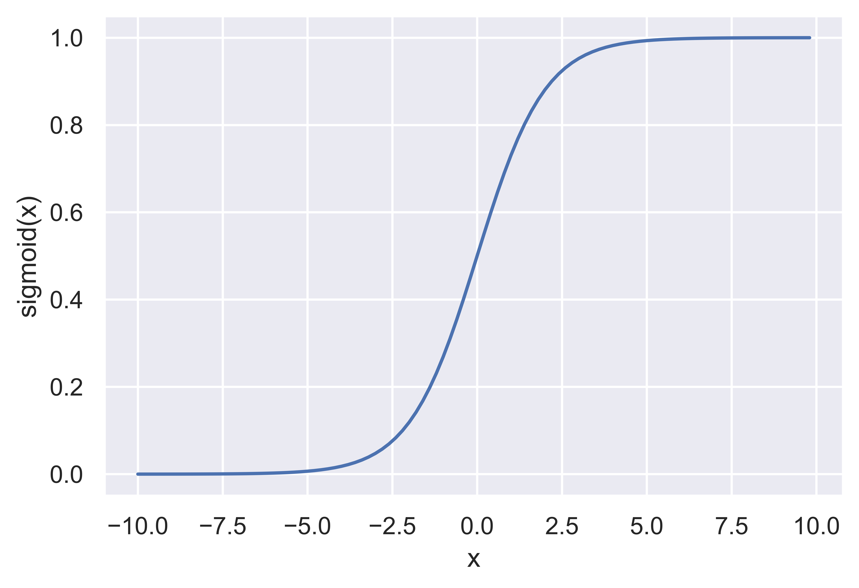
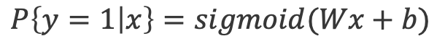
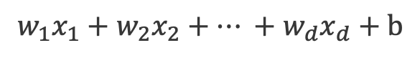
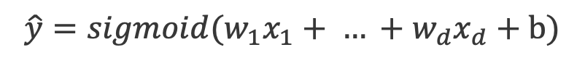
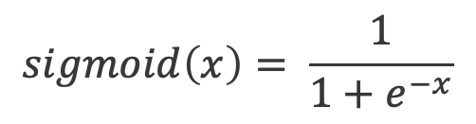
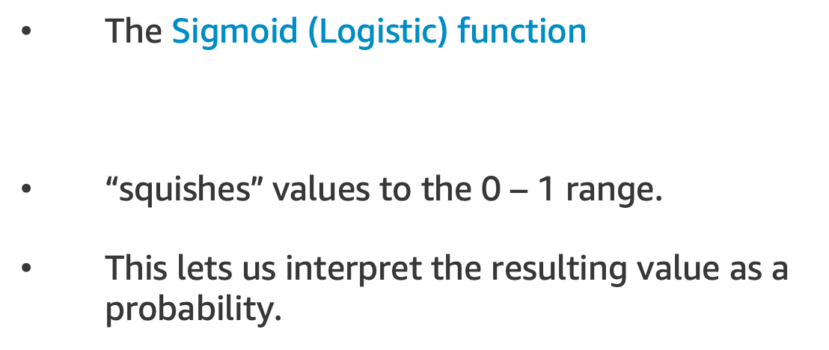
Logistic Regression
$$w_{1}x_{1}+w_{2}x_{2}+… +w_{d}x_{d}+b$$
Idea: We can apply the Sigmoid function to
$$\hat{y}=sigmoid(w_{1}x_{1}+ … +w_{d}x_{d}+b)$$
The Sigmoid (Logistic) function
“squishes” values to the 0 – 1 range.
This lets us interpret the resulting value as a probability.
$$sigmoid\left(x\right)= \frac{1}{1+e^{−x}}$$
$$P\left\{y=1 | x\right\}=sigmoid(Wx+b)$$
Notes:
Now, we finished our discussion for numeric prediction. How about discrete problems? The ones at which we predict some categories.

Slide 22
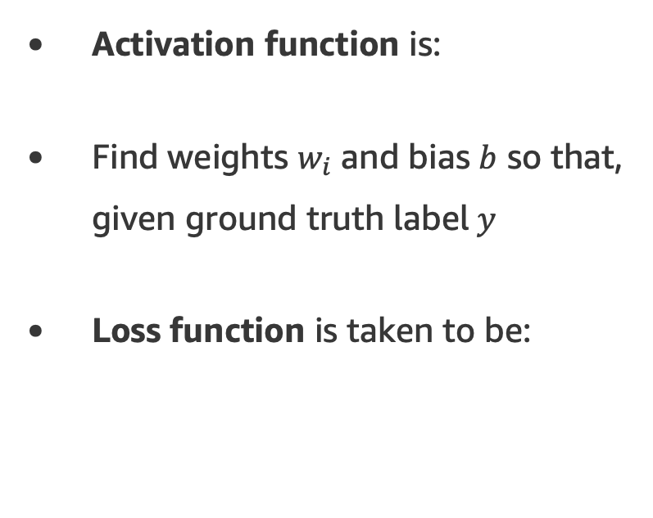
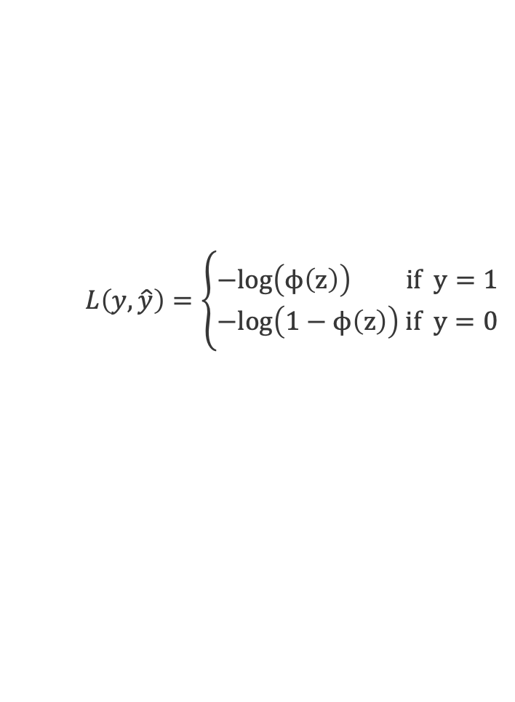
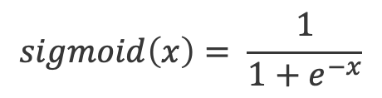
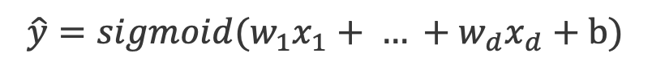
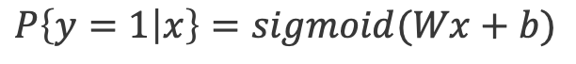
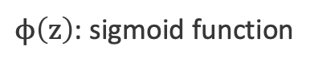
Logistic Regression
$$w_{1}x_{1}+w_{2}x_{2}+… +w_{d}x_{d}+b$$
Idea: We can apply the Sigmoid function to
$$\hat{y}=sigmoid(w_{1}x_{1}+ … +w_{d}x_{d}+b)$$
Activation function is:
Find weights $w_{i}$ and bias $b$ so that, given ground truth label$y$
Loss function is taken to be:
Output
$$sigmoid\left(x\right)= \frac{1}{1+e^{−x}}$$
Activation Function
$$P\left\{y=1 | x\right\}=sigmoid(Wx+b)$$
Weights
$$L\left(y,\hat{y}\right)=\left\{\begin{aligned}−log\left(ϕ\left(z\right)\right) if y=1 \\ −log\left(1−ϕ\left(z\right)\right) if y=0\end{aligned}\right.$$
…
Inputs
$ϕ\left(z\right)$: sigmoid function
Notes:
Now, we finished our discussion for numeric prediction. How about discrete problems? The ones at which we predict some categories.

Slide 23
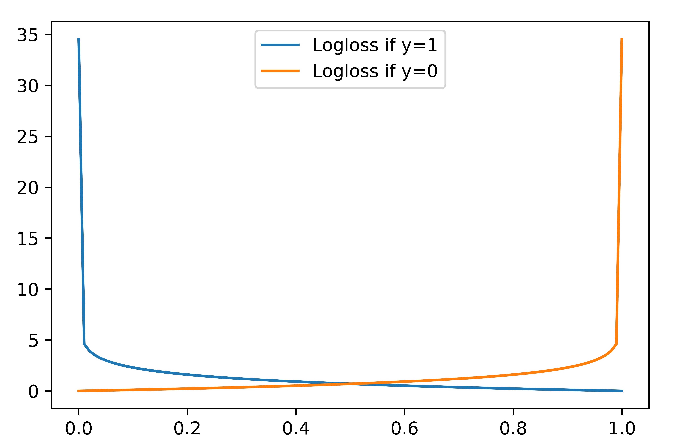
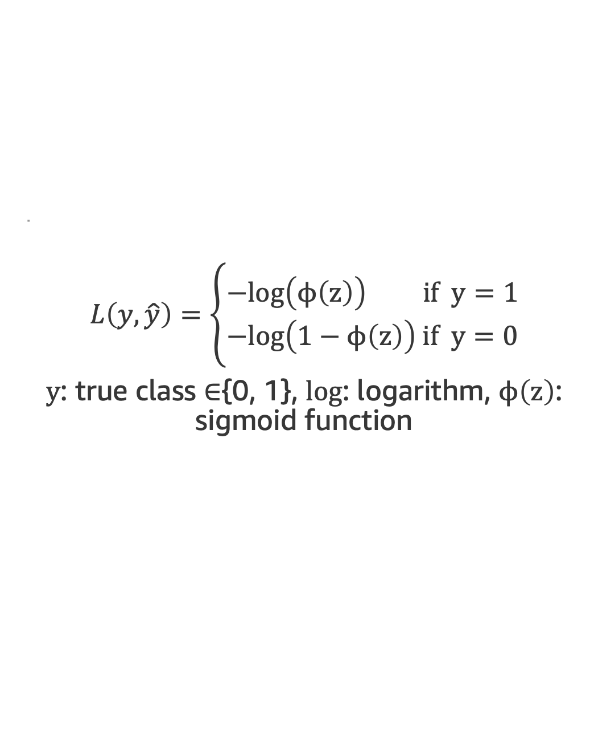
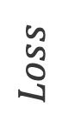
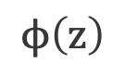
Log-loss (Binary Cross-Entropy)
Loss function for binary classification problems.
=
$$L\left(y,\hat{y}\right)=\left\{\begin{aligned}−log\left(ϕ\left(z\right)\right) if y=1 \\ −log\left(1−ϕ\left(z\right)\right) if y=0\end{aligned}\right.$$
$y$: true class $∈${0, 1}, log: logarithm, $ϕ\left(z\right)$: sigmoid function
$$Loss$$
$$ϕ\left(z\right)$$
Notes:
Here, we introduce a new loss function. For classification problems, we are using log-loss function to minimize with our data. Here, the minimization works similar to linear regression. We again find the set of weights in the logistic regression models that minimizes a loss function (log loss here) with a given dataset.
The equation looks a little bit difficult to understand at first glance. Theoretical reasons of why we select this loss over MSE is beyond the scope of this discussion, but we can mention that this loss function selection helps our models find better weights, in return, better models at the end.

Slide 24
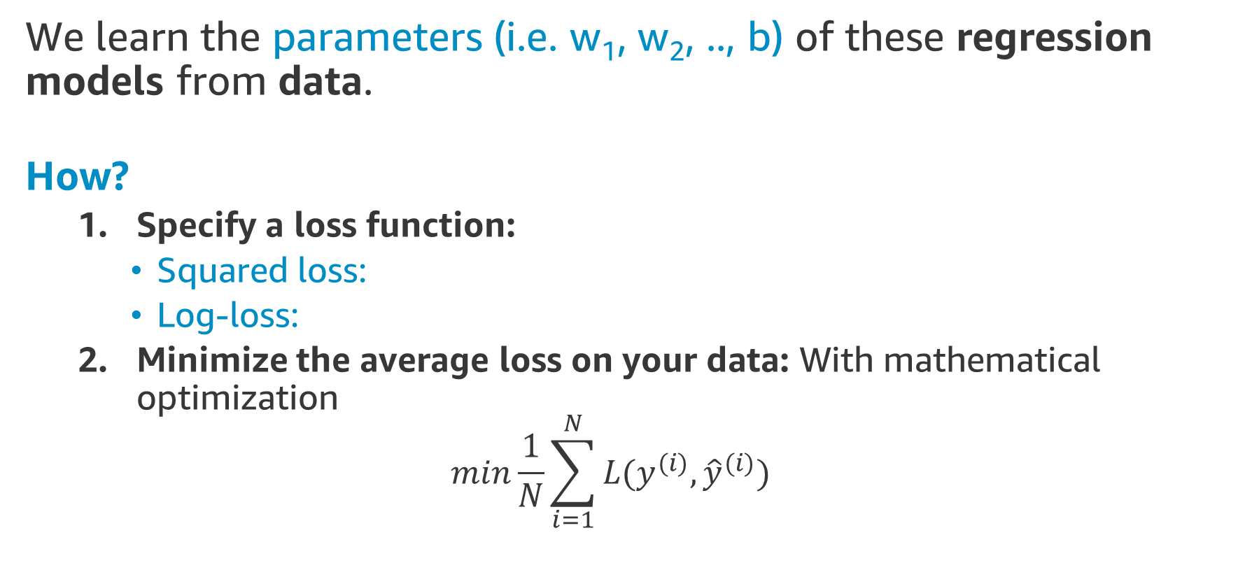
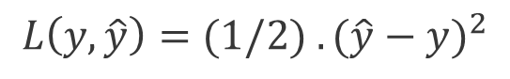
Learning
We learn the parameters (i.e. w₁, w₂, .., b) of these regression models from data.
How?
Specify a loss function:
Squared loss:
Log-loss:
Minimize the average loss on your data: With mathematical optimization
$$min\frac{1}{N}\sum_{i=1}^{N}{L(y^{(i)},{\hat{y}}^{(i)})}$$
$$L\left(y, \hat{y}\right)=(1/2{) .(\hat{y}−y)}^{2}$$
$$L\left(y, \hat{y}\right)=−\left(y.log\left(p\right)+\left(1−y\right).\log\left(1−p\right)\right)$$
Notes:
How do we learn these weights? We will use a mathematical optimization technique. First, we select loss function according to the problem. Second, apply mathematical optimization (next).

Slide 25
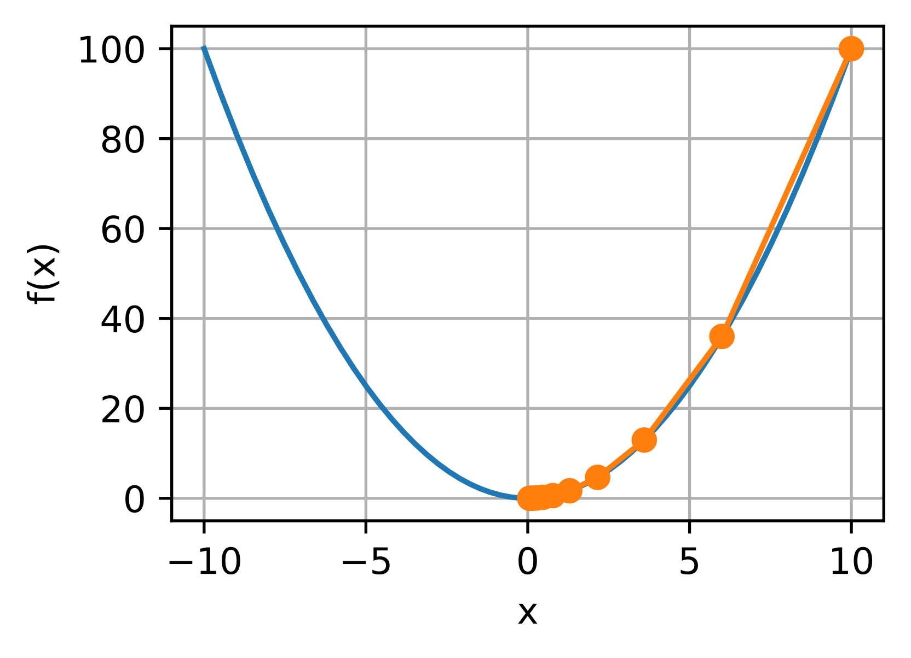


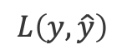
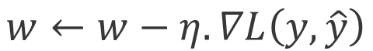
Optimization - Gradient Descent
Gradient Descent finds the minimum of a loss function by moving in the direction of the steepest descent, iteratively.
At each iteration, weights are updated by:
Gradient Descent
$$L\left(y, \hat{y}\right)$$
$$w←w−η.∇L\left(y, \hat{y}\right)$$
Learning rate: Scaler for the update amount
Gradient: Derivative of the loss function with respect to the weight
$$w$$
Notes:
Let’s see more details about this process. Here we introduce one of the most popular optimization methods: Gradient Descent. In this method, we update the weights of the model iteratively by using the multiplication of learning rate and gradient.
Gradient is a mathematical concept. It is simply the mathematical derivative of the loss function with respect to a variable. More details are out of the scope, we can share a link for more details.
Figure on the right shows this process. Assume we have a loss function that looks like a bowl. With grad. descent, we first start at a random point, and then move in the opposite direction of gradient. How much do we move? We move as much as the multiplication of learning rate and gradient. With each move, we go towards to bottom part of this bowl. This happens because gradients point to the direction of increase. See the negative sign in the equation before the learning rate. That changes the sign and puts us moving towards the direction of decrease.
Learning rate here works like a scaler. We want this process to be as smooth as possible. Therefore, learning rate is usually a small number.

Slide 26
Logistic Regression – Hands-on
Exercise: Training a classifier to predict the sentiment of product reviews.
The exercise covers the following topics:
Text pre-processing
Bag of Words Representation
Fit ML Model: Logistic Regression
MLA-NLP-DAY1-LOGREGR-NB.ipynb

Slide 27
Topics for Today
Introduction to Machine Learning
Introduction to NLP
Text Processing
Bag of Words (BoW) Representation
Single Layer Neural Networks
Final Project

Slide 28


Final Project
Apply and experiment with a real-world Amazon dataset.
Compete in the following challenge (your final project)
https://leaderboard.corp.amazon.com/tasks/352
Contest is open until
Sunday 5:00 PM (PST)
Top 3 submissions - this week
Completions

Slide 29
Final Project – Product Safety
Our dataset is made of product reviews that contains the word “burn” or its different forms such as: “burning”, “burnt”, etc.
We will classify them as safety issue or not safety issue.
Motivation:
One of Amazon Compliance’s missions is to protect Amazon customers from products that are potentially dangerous and contribute to build customer trust by ensuring safe, consistent, wholesome products.
The Food Safety team identifies and annotates customer reviews for potential issues.

Slide 30
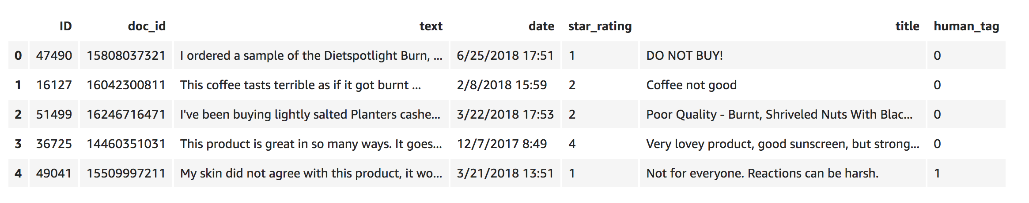
Final Project – Product Safety
The final project is similar to our in-class exercises. It is about detecting unsafe products from product reviews. Data looks like this:
ID: Record ID
doc_id: Document ID
text: Review text body
date: Date of the review
star_rating: Rating of the review (1 to 5)
title: Review title
human_tag: Safety issue (1) or not (0)

Slide 31
Final Project – Product Safety
Not safety issue (human_tag=0):
Not for heavily soiled or burn damaged surfaces. Repeated applications did not help much, nor did a lot of scrubbing.
Burns nice and clean. Can be difficult to open as the plastic cover doesn't always pull up with the tab.
Safety issue (human_tag=1):
These are NOT waterproof. Rained in Phoenix this morning. Turned on lights tonight and one of the boxes caught on fire and nearly burn my house down. Burned the side of my house and then fell in the yard still on fire.

Slide 32
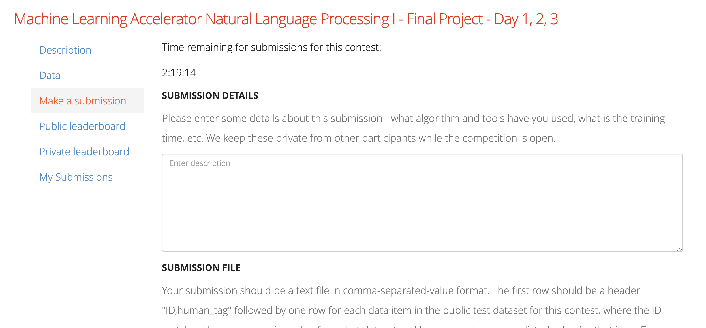
Final Project – Leaderboard
Link: https://leaderboard.corp.amazon.com/tasks/352
You submit your model’s output (a .csv file) to Leaderboard via the ‘Make a Submission’ tab.

Slide 33
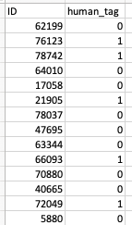
Final Project – Leaderboard
How do I submit to Leaderboard?
You submit your model’s output as a CSV file.
The first row should be a header "ID, human_tag"
.
.
.
.
.
.

Slide 34
Final Project Walkthrough
Let’s open the final project walkthrough notebook. We will see:
How to read the training and test data
Writing predictions to a CSV file.
Open MLA-NLP-DAY1-FINAL-STUDENT NB.ipydb

Slide 35
Final Project-Course Completion
Requirements: At least ONE submission is REQUIRED
Will get a score after each submission
Can improve the score by making INFINITE submissions
After completion, the student and manager will a receive
confirmation email.
Course
Complete
Day 1
Day 2
Day 3

Slide 36
Looking Ahead - Day 2
Neural Networks
Word Vectors
Recurrent Networks
AWS Services

